Slide 1

Arithmetic Sequence
(Next Terms and Common Difference)
Matthayom 6
By Ahbi Mahdianing Rum

Slide 2

MOTIVATION WORDS

Slide 3
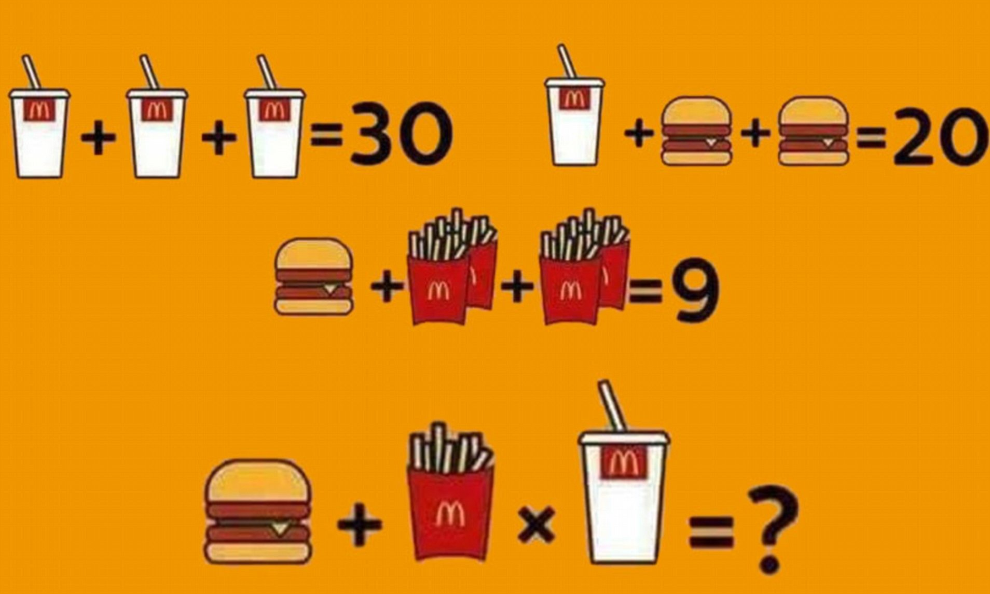
Warming Up Your Mind
15

Slide 4

Definition
An arithmetic sequence is a list of numbers with a definite pattern. the result when you take any number in the sequence then subtract it by the previous one is always the same or constant

Slide 5
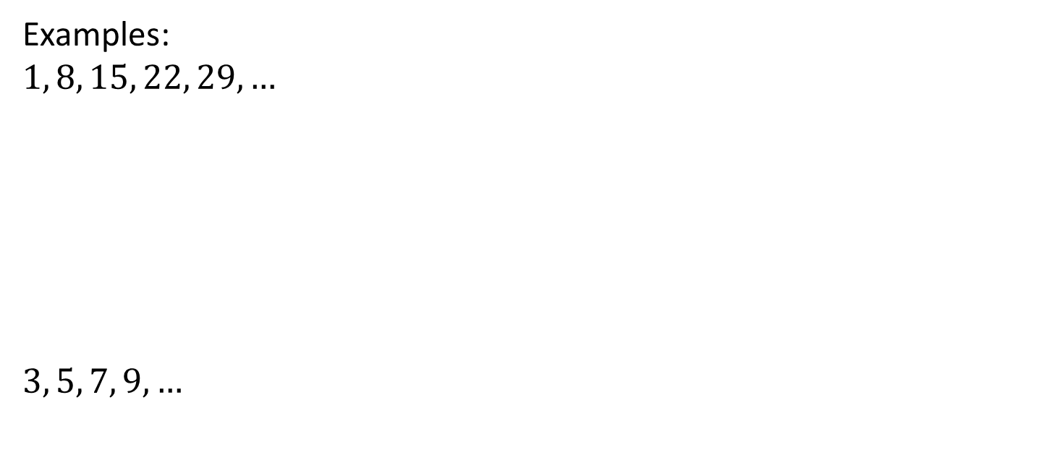
Examples:
$1, 8, 15, 22, 29, …$
$3, 5, 7, 9, …$
1 8 15 22 29
+7
+7
+7
+7
3 5 7 9
+2
+2
+2

Slide 6
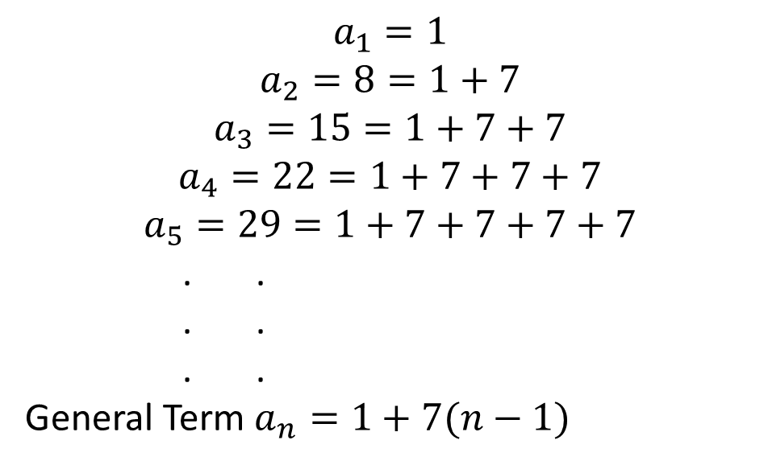
Finding General Term OF arithmetic
Consider the sequence 1, 8, 15, 22, 29, ... The process of finding the general term can be done as follow:
$$a_{1}=1$$
$$a_{2}=8=1+7$$
$$a_{3}=15=1+7+7$$
$$a_{4}=22=1+7+7+7$$
$$a_{5}=29=1+7+7+7+7$$
. .
. .
. .
General Term $a_{n}=1+7(n−1)$

Slide 7
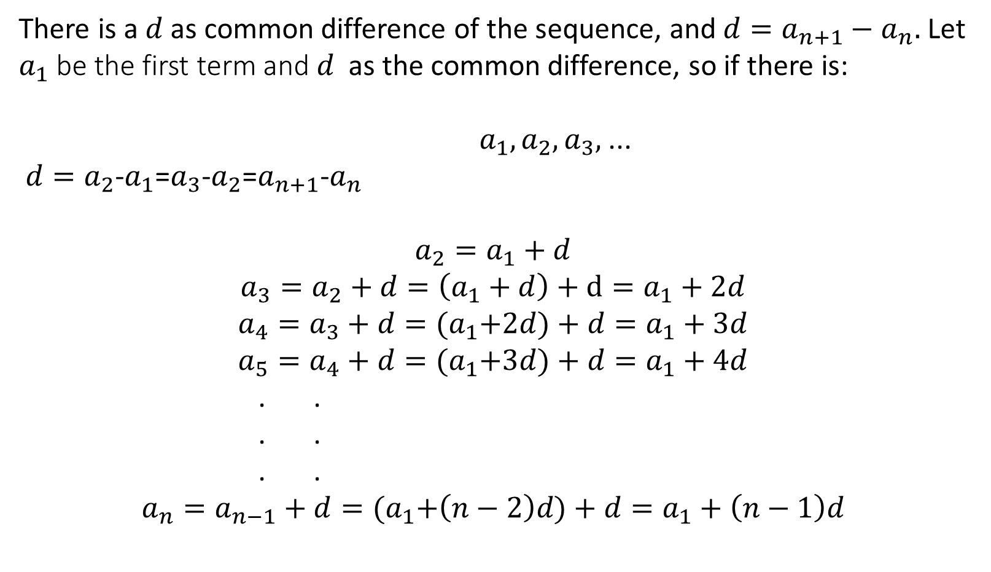
There is a $d$as common difference of the sequence, and $d=a_{n+1}−a_{n}.$ Let $a_{1}$be the first term and $d$ as the common difference, so if there is:
$a_{1},a_{2},a_{3},$...
${d=a}_{2}$-$a_{1}$=$a_{3}$-$a_{2}$=$a_{n+1}$-$a_{n}$
$$a_{2}=a_{1}+d$$
$$a_{3}=a_{2}+d=\left(a_{1}+d\right)+d=a_{1}+2d$$
$$a_{4}=a_{3}+d={(a}_{1}+2d)+d=a_{1}+3d$$
$$a_{5}=a_{4}+d={(a}_{1}+3d)+d=a_{1}+4d$$
. .
. .
. .
$$a_{n}=a_{n−1}+d={(a}_{1}+\left(n−2\right)d)+d=a_{1}+\left(n−1\right)d$$

Slide 8

GENERAL TERM OF AN ARITHMETIC SEQUENCE
a_{n} = a₁ + (n - 1)d
Where:
a₁ is the first term
a_{n} is the nth term
n is the number of terms
d is the common difference

Slide 9
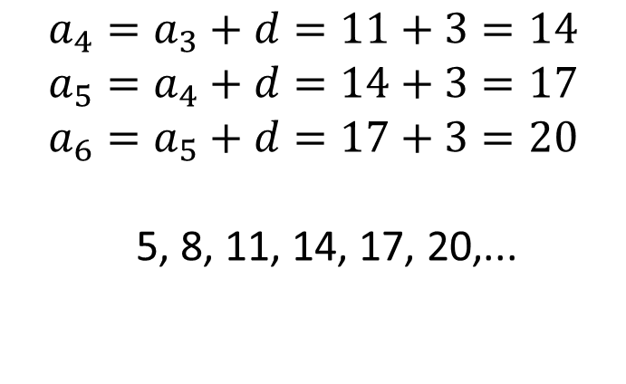

EXAMPLES
1
Determine the common difference and write the three next terms from the arithmetic sequence 5, 8, 11, ...
Solution:
$$d=8−5=11−8=3$$
$$a_{4}=a_{3}+d=11+3=14$$
$$a_{5}=a_{4}+d=14+3=17$$
$$a_{6}=a_{5}+d=17+3=20$$
5, 8, 11, 14, 17, 20,...

Slide 10
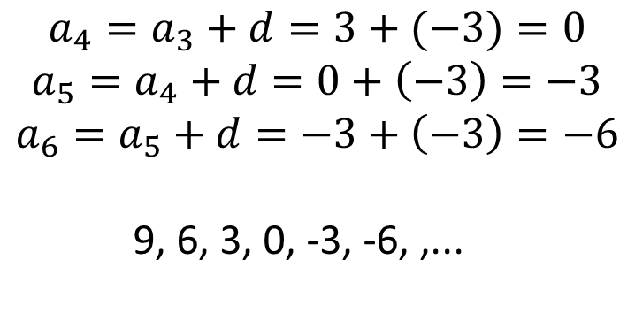

EXAMPLES
Try it by your self!
2
Determine the common difference and write the three next terms from the arithmetic sequence 9, 6, 3, ...
Solution:
$$d=6−3=3−6=−3$$
$$a_{4}=a_{3}+d=3+(−3)=0$$
$$a_{5}=a_{4}+d=0+\left(−3\right)=−3$$
$$a_{6}=a_{5}+d=−3+\left(−3\right)=−6$$
9, 6, 3, 0, -3, -6, ,...

Slide 11
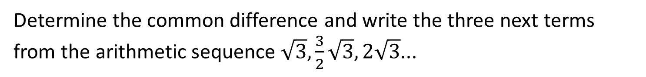
Q U I Z
1
Determine the common difference and write the three next terms from the arithmetic sequence $\sqrt{3},\frac{3}{2}\sqrt{3}, 2\sqrt{3}$...
Beam

Slide 12
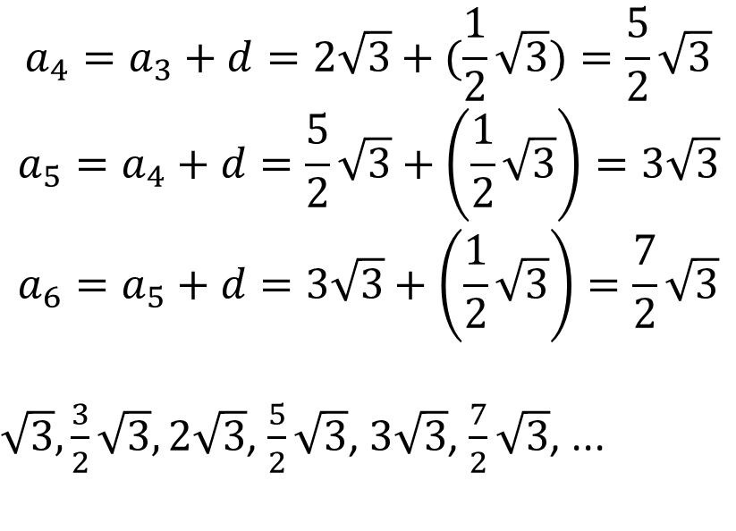
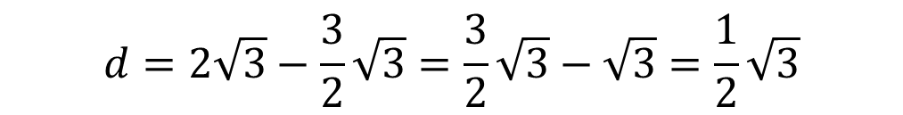
Solution:
$$d=2\sqrt{3}−\frac{3}{2}\sqrt{3}=\frac{3}{2}\sqrt{3}−\sqrt{3}=\frac{1}{2}\sqrt{3}$$
$$a_{4}=a_{3}+d=2\sqrt{3}+(\frac{1}{2}\sqrt{3})=\frac{5}{2}\sqrt{3}$$
$$a_{5}=a_{4}+d=\frac{5}{2}\sqrt{3}+\left(\frac{1}{2}\sqrt{3}\right)=3\sqrt{3}$$
$$a_{6}=a_{5}+d=3\sqrt{3}+\left(\frac{1}{2}\sqrt{3}\right)=\frac{7}{2}\sqrt{3}$$
$\sqrt{3},\frac{3}{2}\sqrt{3}, 2\sqrt{3}$, $\frac{5}{2}\sqrt{3}$, $3\sqrt{3}$, $\frac{7}{2}\sqrt{3}$, ...

Slide 13
General Term Of Arithmetic Sequence

Slide 14

MOTIVATION WORDS

Slide 15
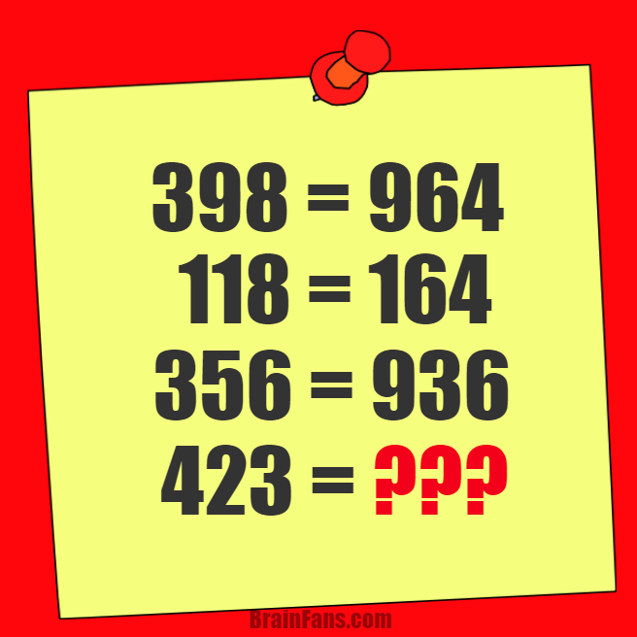
Warming Up Your Mind
169

Slide 16
GENERAL TERM OF AN ARITHMETIC SEQUENCE
a_{n} = a₁ + (n - 1)d
Where:
a₁ is the first term
a_{n} is the nth term
n is the number of terms
d is the common difference

Slide 17
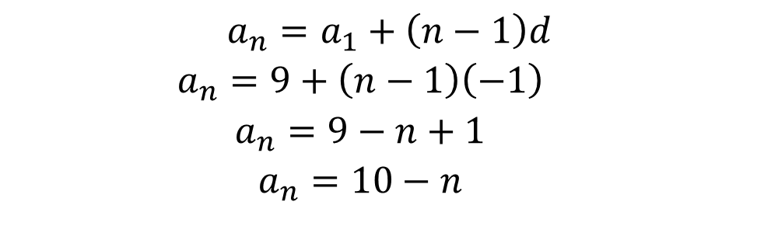
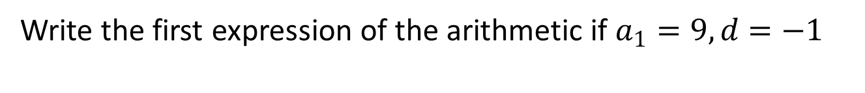
EXAMPLES
1
Write the first expression of the arithmetic if $a_{1}=9, d=−1$
Solution:
$$a_{n}=a_{1}+\left(n−1\right)d$$
$$a_{n}=9+\left(n−1\right)\left(−1\right)$$
$$a_{n}=9−n+1$$
$$a_{n}=10−n$$

Slide 18
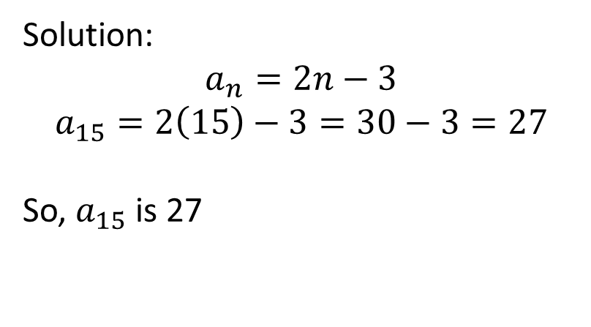
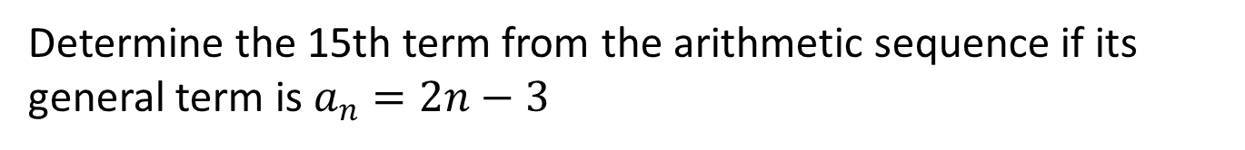
EXAMPLES
2
Determine the 15th term from the arithmetic sequence if its general term is $a_{n}=2n−3$
Solution:
$$a_{n}=2n−3$$
$$a_{15}=2\left(15\right)−3=30−3=27$$
So, $a_{15}$is 27

Slide 19

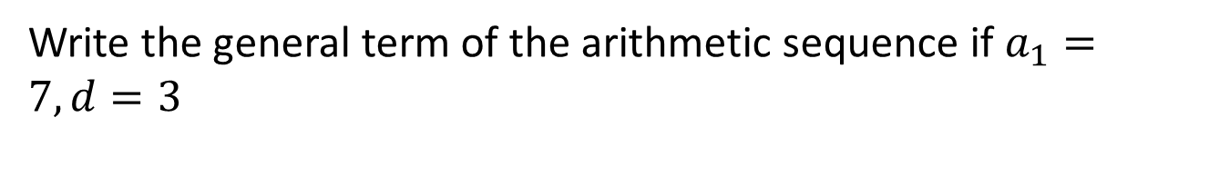
EXAMPLES
Try it By Yourself!
3
Write the general term of the arithmetic sequence if $a_{1}=7, d=3$
Solution:
$$a_{n}=a_{1}+\left(n−1\right)d$$
$$a_{n}=7+\left(n−1\right)3$$
$$a_{n}=7+3n−3$$
$$a_{n}=4+3n$$

Slide 20
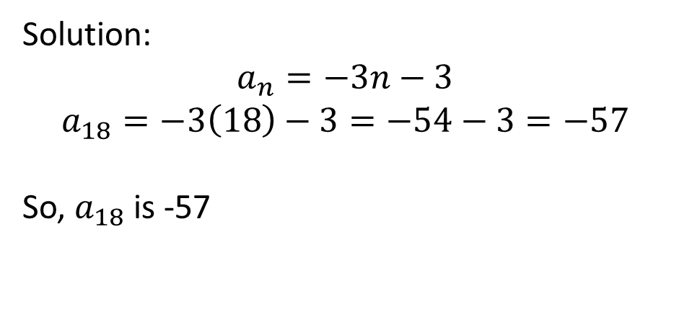
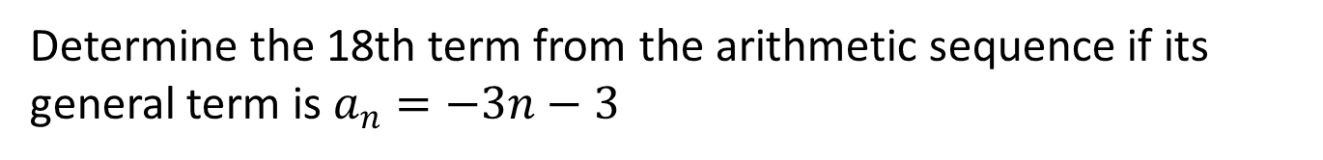
EXAMPLES
Try it By Yourself!
4
Determine the 18th term from the arithmetic sequence if its general term is $a_{n}=−3n−3$
Solution:
$$a_{n}=−3n−3$$
$$a_{18}=−3\left(18\right)−3=−54−3=−57$$
So, $a_{18}$is -57

Slide 21
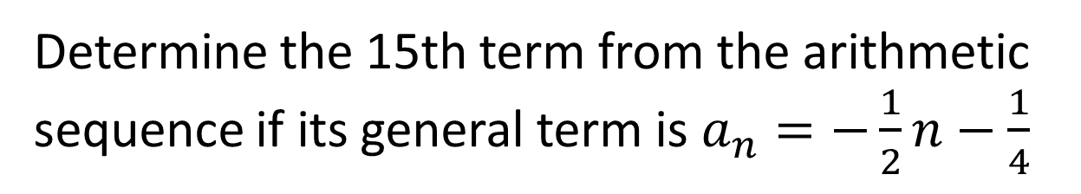
Q U I Z
Determine the 15th term from the arithmetic sequence if its general term is $a_{n}=−\frac{1}{2}n−\frac{1}{4}$
Beam
Sang
Gai
nut

Slide 22
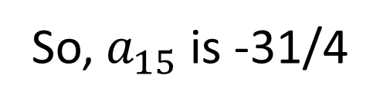
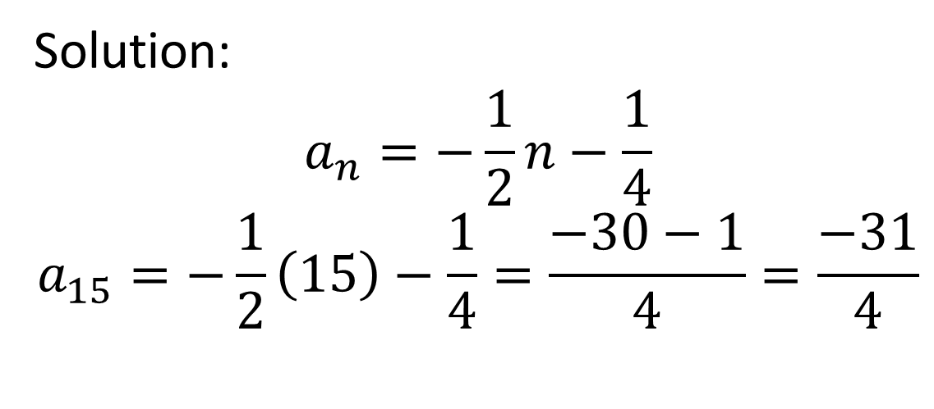
Solution:
$$a_{n}=−\frac{1}{2}n−\frac{1}{4}$$
$$a_{15}=−\frac{1}{2}\left(15\right)−\frac{1}{4}=\frac{−30−1}{4}=\frac{−31}{4}$$
So, $a_{15}$is -31/4

