Slide 1

Arithmetic Sequence
(Spesific Term by Using Arithmetic Sequence formula)
Matthayom 6
By Ahbi Mahdianing Rum

Slide 2
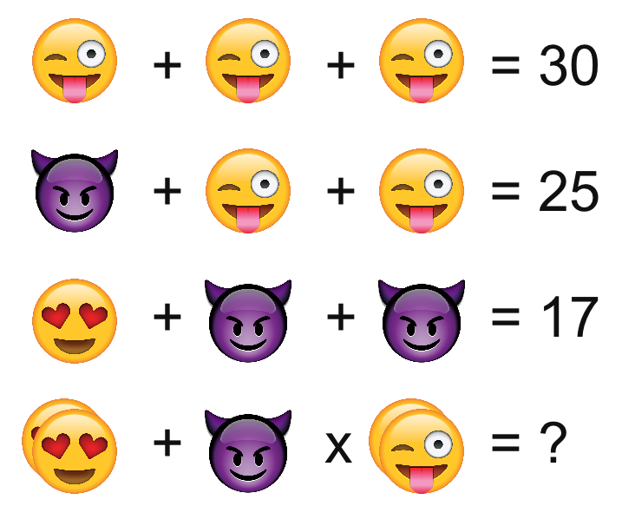
114

Slide 3

GENERAL TERM OF AN ARITHMETIC SEQUENCE
a_{n} = a₁ + (n - 1)d
Where:
a₁ is the first term
a_{n} is the nth term
n is the number of terms
d is the common difference

Slide 4
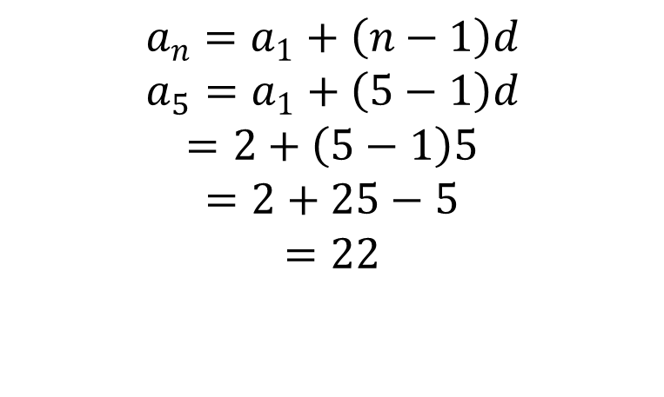
EXAMPLES
1
Find the 5th terms of arithmetic sequence $if a_{1}=2, d=5$
Solution:
$$a_{n}=a_{1}+\left(n−1\right)d$$
$$a_{5}=a_{1}+\left(5−1\right)d$$
$$=2+\left(5−1\right)5$$
$$=2+25−5$$
$$=22$$

Slide 5
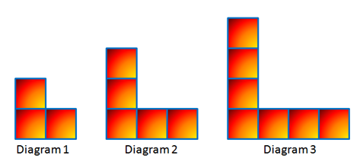
EXAMPLES
2
Find the general term of the sequence from the figures bellow and find the 8th term of the sequence

Slide 6
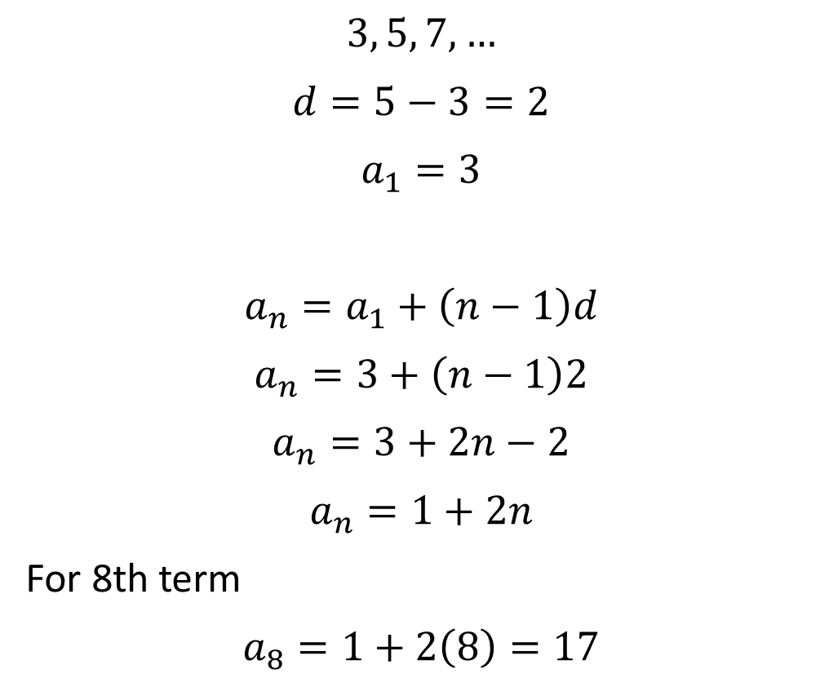
Solution
$$3, 5, 7,…$$
$$d=5−3=2$$
$$a_{1}=3$$
$$a_{n}=a_{1}+\left(n−1\right)d$$
$$a_{n}=3+\left(n−1\right)2$$
$$a_{n}=3+2n−2$$
$$a_{n}=1+2n$$
For 8th term
$$a_{8}=1+2\left(8\right)=17$$

Slide 7
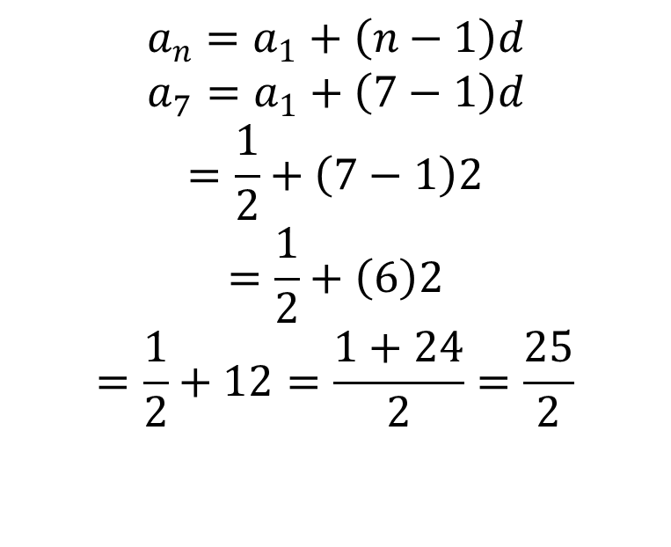
EXAMPLES
Try it by yourself!
3
Find the 7th terms of arithmetic sequence $if a_{1}=\frac{1}{2}, d=2$
Solution:
$$a_{n}=a_{1}+\left(n−1\right)d$$
$$a_{7}=a_{1}+\left(7−1\right)d$$
$$=\frac{1}{2}+\left(7−1\right)2$$
$$=\frac{1}{2}+\left(6\right)2$$
$$=\frac{1}{2}+12=\frac{1+24}{2}=\frac{25}{2}$$

Slide 8
LET’S PLAY THE SHOUT THE NUMBERS GAME
How to play:
I will start to mention random number
If your number get called, you should mention other’s number as fast as possible
And repeat no 2
Don’t mention the same number as before
The one who mention other’s the number slowly or mention the same number will got punishment

Slide 9
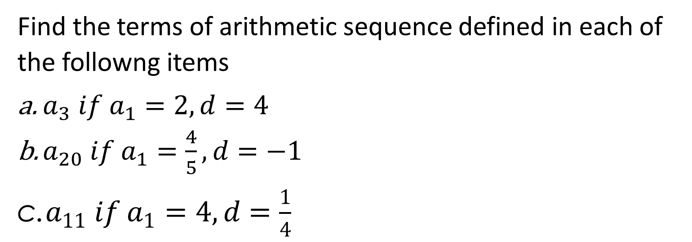
WORKSHEET
Find the terms of arithmetic sequence defined in each of the followng items
$a_{3} if a_{1}=2, d=4$
$a_{20} if a_{1}=\frac{4}{5}, d=−1$
$a_{11} if a_{1}=4, d=\frac{1}{4}$

Slide 10
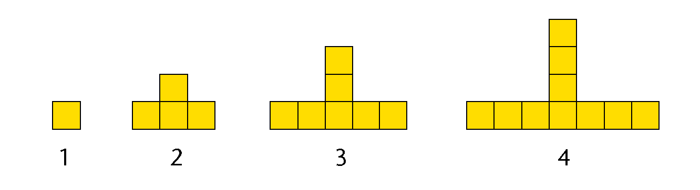
Q U I Z
Find the general term of the sequence from the figures above (using arithmetic) and find the 10th term of the sequence!

Slide 11
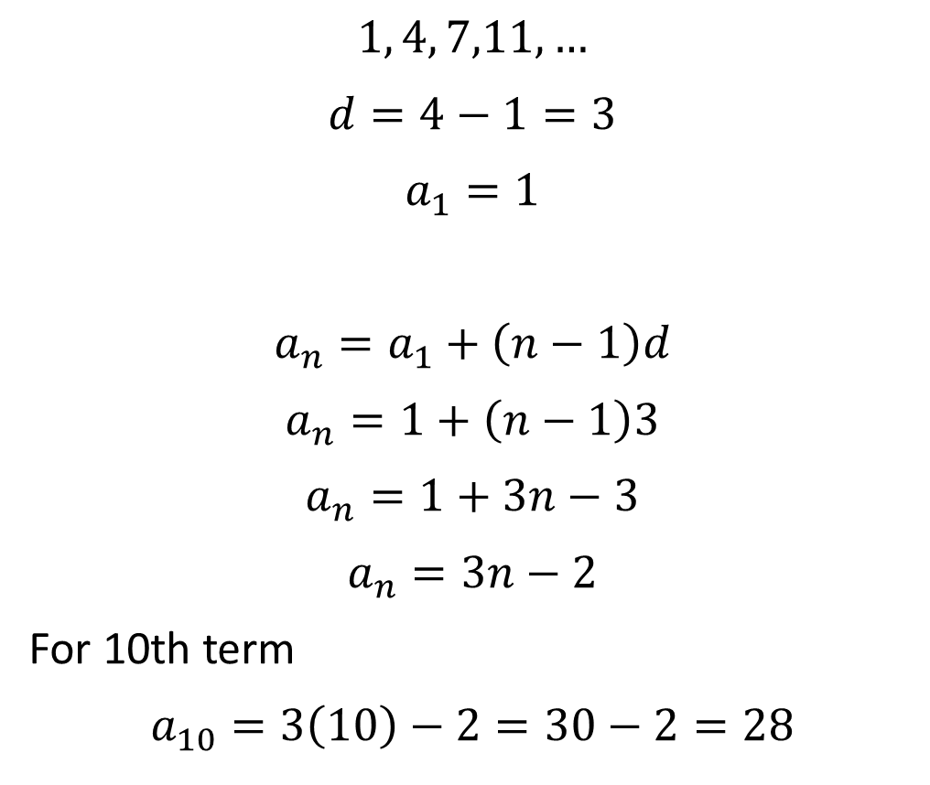
Solution
$$1, 4, 7,11,…$$
$$d=4−1=3$$
$$a_{1}=1$$
$$a_{n}=a_{1}+\left(n−1\right)d$$
$$a_{n}=1+\left(n−1\right)3$$
$$a_{n}=1+3n−3$$
$$a_{n}=3n−2$$
For 10th term
$$a_{10}=3\left(10\right)−2=30−2=28$$

