Slide 1

Geometric Sequence
(Definition and Common Ratio)
Matthayom 6
By Ahbi Mahdianing Rum

Slide 2
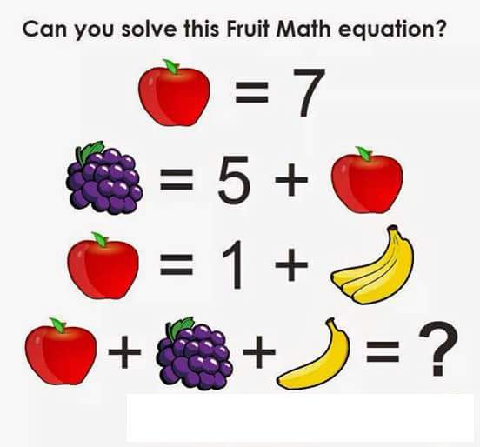
WARM UP YOUR MIND
21

Slide 3
What is Geometric Sequence?
In a Geometric Sequence each term is found by multiplying the previous term by a constant.
Example:
1, 2, 4, 8, 16, ...
1 2 4 8 16
x 2
x 2
x 2
x 2

Slide 4


1 2 4 8 16
x 2
x 2
x 2
x 2
You can see $\frac{2}{1}=\frac{4}{2}=\frac{8}{4}=\frac{16}{8}=2$
Or we can write them as:
$$\frac{a_{2}}{a_{1}}=\frac{a_{3}}{a_{2}}=\frac{a_{4}}{a_{3}}=\frac{a_{5}}{a_{4}}=\frac{a_{n+1}}{a_{n}}$$
Called as Common Ratio (r), so $r=\frac{a_{n+1}}{a_{n}}$

Slide 5


$$r=\frac{a_{2}}{a_{1}}→a_{2}=a_{1}r$$
$$a_{2}=a_{1}r$$
$$a_{3}=a_{2}r=\left(a_{1}r \right)r=a_{1}r^{2}$$
$$a_{4}=a_{3}r=\left(a_{1}r^{2} \right)r=a_{1}r^{3}$$
. .
. .
. .
$$a_{n}=a_{n−1}r=\left(a_{1}r^{n−2} \right)r=a_{1}r^{n−1}$$

Slide 6



GENERAL TERM OF GEOMETRIC SEQUENCE
$a_{n}=a_{1}∙r^{n−1}$
Where:
$a_{1}$ is the first term
$a_{n}$ is the nth term
n is the number of terms
r is the common Ratio

Slide 7


EXAMPLES
1
Determine the common ratio and write the three next terms from the geometric sequence 2, 4, 8, ...
Solution:
$$r=\frac{4}{2}=\frac{8}{4}=2$$
$$a_{4}=a_{3}∙r=8∙2=16$$
$$a_{5}=a_{4}∙r=16∙2=32$$
$$a_{6}=a_{5}∙r=32∙2=64$$
Geometric Sequence:
2, 4, 8, 16, 32, 64 ...

Slide 8

EXAMPLES
2
Determine the common ratio and write the three next terms from the geometric sequence 2, 1, ½ , ...
Solution:
$$r=\frac{1}{2}=\frac{\frac{1}{2}}{1}=\frac{1}{2}$$
$$a_{4}=a_{3}∙r=\frac{1}{2}∙\frac{1}{2}=\frac{1}{4}$$
$$a_{5}=a_{4}∙r=\frac{1}{4}∙\frac{1}{2}=\frac{1}{8}$$
$$a_{6}=a_{5}∙r=\frac{1}{8}∙\frac{1}{2}=\frac{1}{16}$$
Geometric Sequence:
2, 1, ½, ¼, 1/8, 1/16, ...

Slide 9
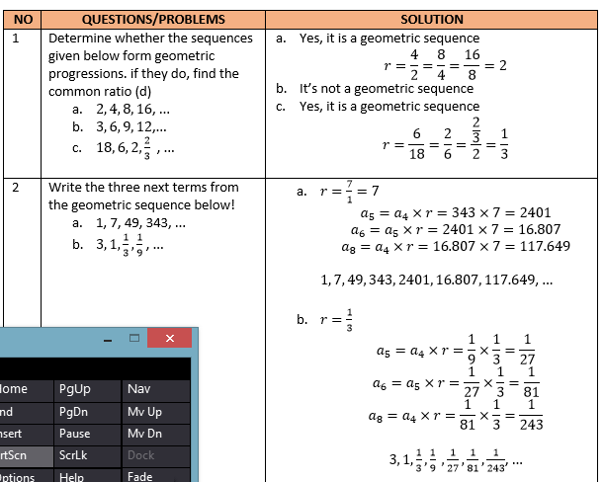

Slide 10
LET’S PLAY THE SHOUT THE NUMBERS GAME
How to play:
I will start to mention random number
If your number get called, you should mention other’s number as fast as possible
And repeat no 2
Don’t mention the same number as before
The one who mentiom the number slowly or mention the same number will got punishment

